Slide 1
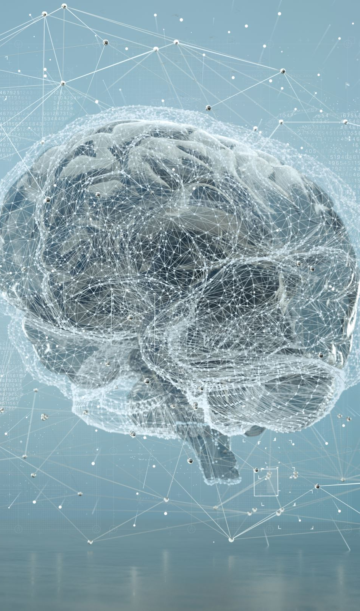
COMP6231
Foundations of Artificial Intelligence
Richard Watson

Slide 2
Comp6231 Overview:
Foundational concepts in AI, with a balance between:
symbolic (logic-based) AI and
non-symbolic (data-driven) AI
classical AI techniques such as search algorithms,
contemporary machine learning techniques including neural networks and probabilistic models
focus on problem-solving, reasoning, and learning.

Slide 3
Scope of AI types
Symbolic reasoning and search (non-learning)
  blind search, heuristic search, adversarial search, MCTS, constraint sat/solve, planning, logical reasoning
Machine learning
  Non-ANN:
    Regression models, decision trees, random forests, Support Vector Machines (SVMs), K-Nearest Neighbors (KNN), Naive Bayes classifiers, Bayesian networks
  Artificial Neural Networks
    Classification, clustering, regression/curve fitting
    Deep learning
      Generative AI
        CNNs, GANs, image generation
        Large Language Models: chatbots
Classical AI
This module

Slide 4
Teaching methods/resources
Wiki is being retired → Moodle
Readings and viewings
  The Social Dilemma
    viewing parties
  The AI dilemma
Text book…
Artificial Intelligence a Modern Approach
(Russel and Norvig)
Assessment: 100% exam

Slide 5

You and AI
A “You and AI” context which grounds the topics in
What it all means for you and your role in/with AI
philosophical, cog sci, historical contexts
practical implications of AI across different domains
the role, impact and ethical considerations of responsible AI
You are invited to reflect on
how AI compares to your own intelligence
what we want from AI of the future, and our relationship to it.

Slide 6
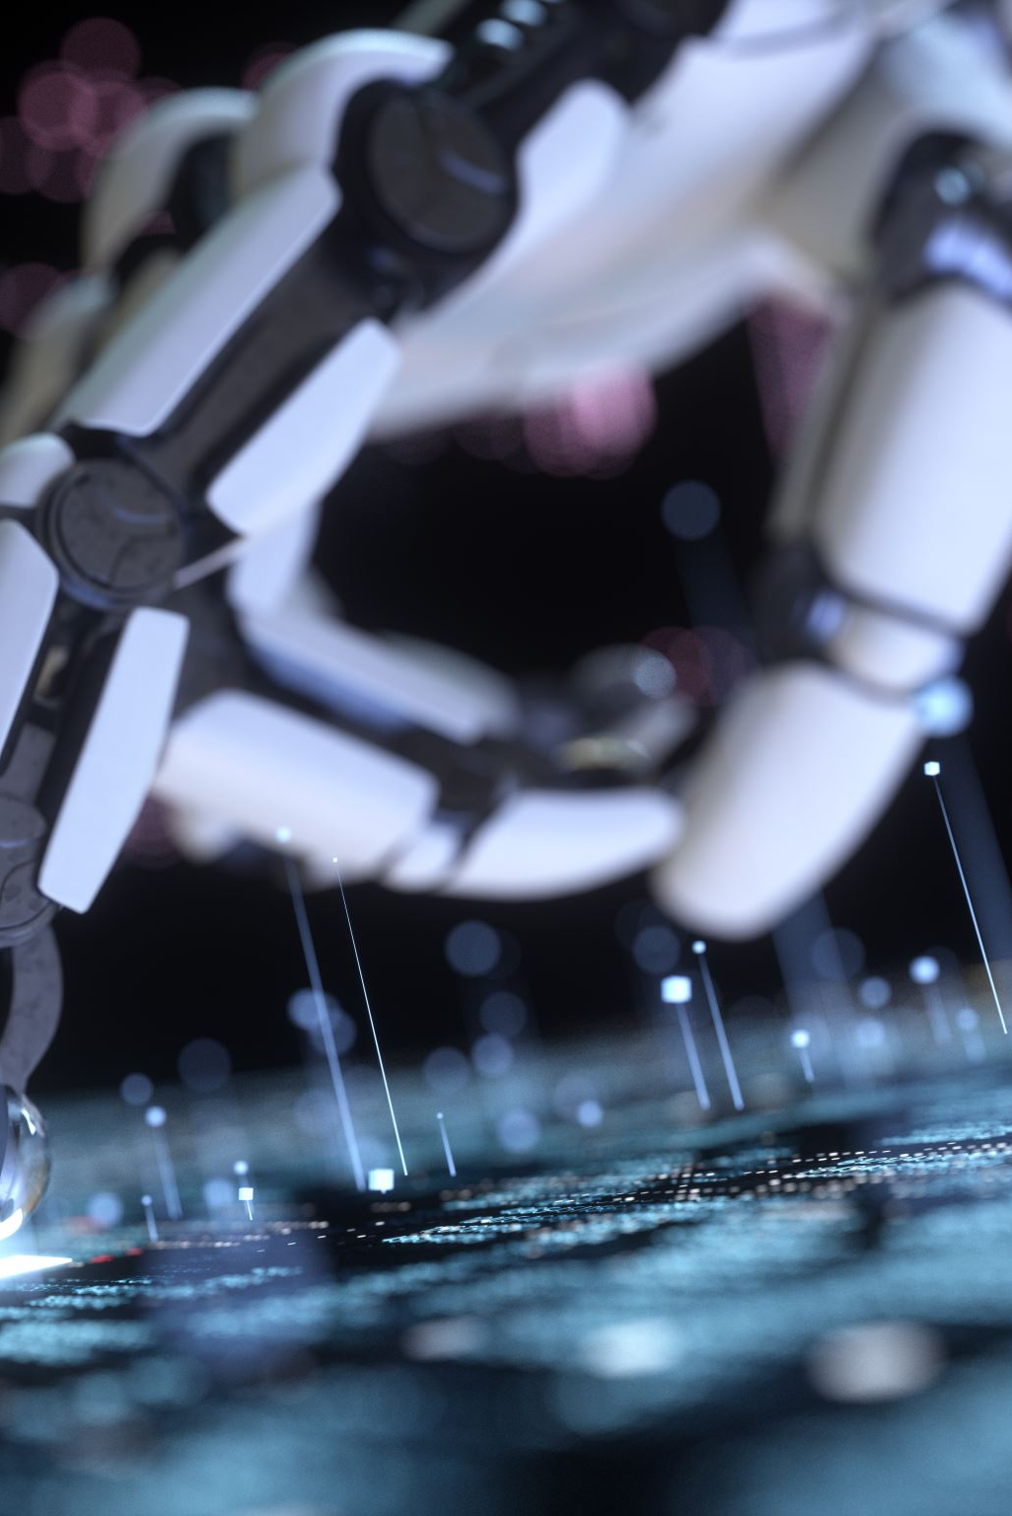
AI now and future
Your hopes for AI?
  What are the most exciting/beneficial areas of AI?
  …now or in the near future?

Slide 7
What do you think are the most exciting/optimistic areas of AI?
nhs and healthcare
prototyping
theorem prooving
medical research
medical science
ai in healthcare
self-driving
alphafold/pharma
use in medicine
network optimisation
chatgpt
gmos
teaching
quant finance
coursework
replying to emails
video generation
animation industries
engineering
cancer research
cancer diagnosis
medical diagnosis
medical field
zimbabwe tb @prisons
ai
education
chatbot
automation
doing my work for me
code gen
robotics
medicine
self driving cars
e-girlfriends
widely accessible
general use chatbots
essay
mondaine tasks
pattern recognition
medical detection
.
driving
ai girlfriend
cheating
assistive learning
finance
entertainment
fake news articles
efficiency
new stuff
agi
lip
medical applications
making my life easy
healthcare
choose food
italian brainrot
space
fast feedback
hardware integration
pharmaceuticals
medical
time
me
research
translation
problem solving
quicker computation
coding
life
true ai
game design
crpg games
searching
data analysis
roombas
governance
diagnostics
searching data
disability support
easier learning
health
drones
gaming
oponents in games
brainrot
personal response
innovation
free up human time
cancer screenings

Slide 8
artificial general intelligence
no
yes
We are very close to AGI
AGI is inevitable?

Slide 9
What is missing from current abilities of AI?

Slide 10
What is missing from current abilities of AI?
unlimited context
long term memory
hairmaking
critical thinking
humanity
consistency
common sense
emotion
being cognizant
correctness
human reasoning
fact-checking
intelligence
being unbiased
real logic
free will
trust
accurate sources
regulation
humour
replacing my job
logic
problem solving
speed
creativity
consciousness
originality
desire
ai gf
soul
critique
accuracy
fact checking
maths
empathy
lying
reliability
memory
innovation
efficiency
not to hallucinate
true creativity
advertising
computing power
adaptability
data protection laws
flawless plagiarism
ethical standards
not truthful
saying i don’t know
source citing
reacting to unknown
start from 0 to 1

Slide 11

How do you and AI compare?
Knowledge
Reasoning
Values
Judgement
Intuition
Other?

Slide 12
What is the point in learning AI?
AI is the hot new thing – if you’re not doing AI what ARE you doing!?`
Everything in CS, AI can already do better
AI will do intelligence better than we do intelligence.
AI will do AI better than we do AI
At best we will be AI ‘wranglers’/users
We cant compete with the huge corporations
The things that AI cant do at the moment will be done soon
(and by huge corps, not by us)
What’s the point in learning anything?
  whatever you need to know is on your phone
  scroll some rubbish (that the AI feeds you), and don’t think about it…

Slide 13
What is the point in humans,
AI is clearly better!?
Am I a kind of LLM but not as good?
Is AI clearly superior to us / or going to be?
Is our intel a bit rubbish/confused/limited?
A chance to eliminate all those human shortcomings (like subjectivity, emotions, bias, ignorance, fallible reasoning)
Are we redundant?
Should we give up authority to AI?
Or, is AI just a tool? (we are the boss)
Our human qualities are precious, AI doesn’t have them, don’t give it more importance/power than it deserves

Slide 14
Risks and responsibilities
Is AI a threat to our existence? (an agent of destruction)
Is the way we use AI a threat to our well-being? (we are the agent of destruction, not AI)
How do we steer a safe path?
Who is best placed to do that?
What are your responsibilities in that?

Slide 15
Your views
How optimistic are you about the future of AI?
terrified/certain doom
excited/its gonna be great!

Slide 16
More to discuss later:
Technology and our vision of ourselves: from clockwork to LLMs
Are artificial intelligence and natural intelligence different in kind?
Where are we headed, and where do we want to go?
AI in comparison to other disruptive technologies.
Who is in charge of AI?
What is your role/responsibility?

Slide 17
What is there to learn about all that?
How did we get here?
Historical context, scope, key concepts and relation to other disciplines.
AI paradigms
Symbolic vs. Non-symbolic approaches. Knowledge vs search. Inference vs learning.
Intelligence: Natural vs artificial.
AI as science vs Engineering/ Technology
What is intelligence?
Philosophical foundations
Behavioural test (Turing Test) vs ‘what’s inside?’
How special are we, where does natural intelligence come from
To build stuff vs to understand stuff

Slide 18
What is there to learn about all that?
How did we get here?
Historical context, scope, key concepts and relation to other disciplines.
AI paradigms
Symbolic vs. Non-symbolic approaches. Knowledge vs search. Inference vs learning.
Intelligence: Natural vs artificial.
AI as science vs Engineering/ Technology
What is intelligence?
Philosophical foundations
Behavioural test (Turing Test) vs ‘what’s inside?’
How special are we, where does natural intelligence come from
To build stuff vs to understand stuff

Slide 19
Definitions
Q. What is artificial intelligence?
A1. “It is the science and engineering of making intelligent machines, especially intelligent computer programs. It is related to the similar task of using computers to understand human intelligence, but AI does not have to confine itself to methods that are biologically observable.”
  John McCarthy, 2007.
A2. It’s aim is “to build intelligent entities”.
  Russell & Norvig, AIAMA2e

Slide 20
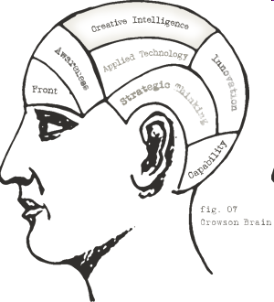
What is needed for
Intelligence?
Insight
Social Ability
Embodiment
Emotional intel
Knowledge
Common Sense
Wisdom
Language
Foresight
IQ
Reasoning
Logic
Rationality
Creativity
Agency
Learning

Slide 21



What is Intelligence?
Abstract reasoning
Practical performance

Slide 22
What is AI? (c.f. Aaron Sloman)
Is AI getting machines to behave like the ones in the movies?
Including having emotions? Including human-like robots?
Is AI
  engineering? science? technology?
  psychology? philosophy? entertainment?
All of the above

Slide 23
AI is a (relatively) new approach to some very old questions:
What are minds and how are they related to bodies (inc. brains)?
What is intelligence, and can machines have it?
What are feelings, qualia/sensations, emotions, beliefs, desires, intentions, aims, selves, ...Etc?
Qualia: subjective, private qualities of conscious experience (e.g. sensation of red, perceiving an object, …)

Slide 24

Interdisciplinary AI
Art
Cybernetics
Music
Biology
Linguistics
Neuroscience
Literature
Psychology
Mathematics
Alife
A.I.
Computer Science
Robotics
Operations Research
Economics
Control Theory
Philosophy
Engineering
Logic

Slide 25

Can machines have minds?
ONE (PARTIAL) ANSWER: It is obvious that machines can have minds and be intelligent, because – Humans are machines and they have minds and intelligence – The same can be said of other animals, e.g. chimpanzees, elephants, dolphins, dogs, crows, and others.
So that leads us to rephrase our questions: What sorts of machines are there, and what sorts of minds and what sorts of intelligence can the different sorts have?
  One of the roles of AI is to investigate these questions.
  Another is to help us build new kinds of useful machines.
Or, is there a sense in which a human is not a machine?
Or not a computer (computational functinonalism)?

Slide 26
AI has two main kinds of goals
Science i.e. studying things that already exist or might exist, explaining how they work
searching for general principles relevant to understanding people, other animals, intelligent machines of the future, and perhaps creatures from other parts of the universe
Engineering. Using that knowledge to solve practical problems, including
making new useful kinds of machines,
producing new forms of entertainment
perhaps helping us manage ourselves better, e.g. in education, therapy, decision-making, ...
because we understand ourselves better
because we have new tools.

Slide 27
AI and computer science
AI uses computer science, just as physics uses mathematics, but AI is not computer science, just as physics is not mathematics.
AI uses computers because they are the best available tool, not because they are the object of study.
If we knew how to make brains we could use those instead of computers, for some of the sub-tasks of modelling or explaining natural intelligence.
Already there are attempts to build neural networks that are partly like brains, and do not work like ordinary computers.
But brain science is not computer science or AI either.

Slide 28
Are brains computers?
Brains certainly process information, of many different kinds in many different ways.
We do not know yet whether there are some mechanisms they use that cannot work on computers as we currently know them, or whether future computers with different basic mechanisms (e.g. chemical mechanisms?) will be needed to replicate some brain functions.
Some brain functions, e.g. playing chess, making plans, solving equations can already be replicated on computers – and all the new exciting stuff from LLMs, Natural language processing and understanding, etc..

Slide 29
Some AI researchers are primarily interested in
The Science:
  e.g. trying to understand and model how human or animal intelligence works (vision, learning, reasoning, language use, motor control etc.)
The Engineering:
  e.g. trying to build useful new kinds of machines, including machines that are more intelligent than humans.
  There is more money available to support the engineering aims, and they are often easier to work on, so more people work on those aims, but they indirectly contribute to the first aim (AI as science)
Common to science and engineering aims: Building WORKING Models
  To test theories, and to perform useful tasks
because we understand ourselves better
because we have new tools.

Slide 30
What’s important here?
Learning the techniques behind AI
The context of history, philosophy and cognitive science
Your role and responsibilities in the future of AI
Developing your critical thinking and your personal, ethical and socio-political values
You!
  Your precious unique contribution to the world

